Slide 1
M8

Slide 2
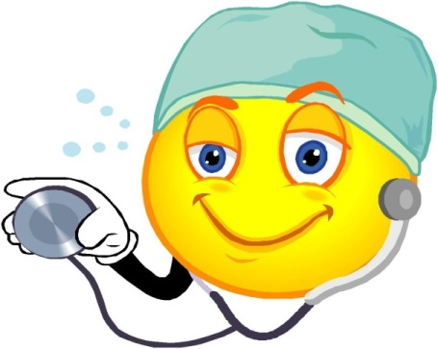
Organ-specific and tissue-specific manifestations
The disease-causing microbes enter the body through these different means.
Where do they go then?

Slide 3
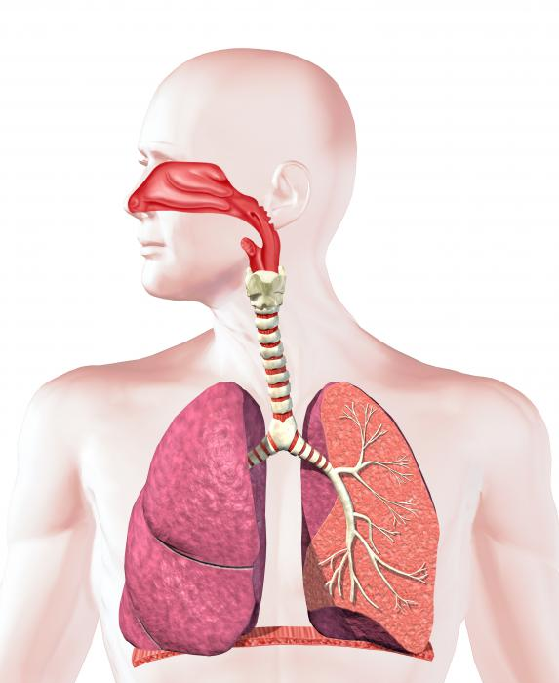
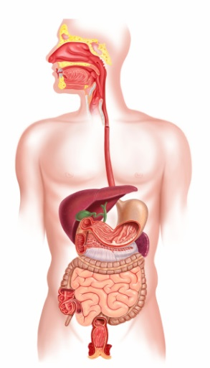
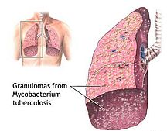
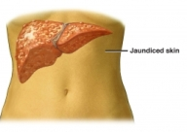
Organ-specific and tissue-specific manifestations
Different species of microbes seem to have evolved to home in on different parts of the body.
This selection is connected to their point of entry.
If they enter from the air via the nose, they are likely to go to the lungs.
If they enter through the mouth, they can stay in the gut lining like typhoid causing bacteria.
Or they can go to the liver, like the viruses that cause jaundice.
This is seen in the bacteria causing tuberculosis.

Slide 4
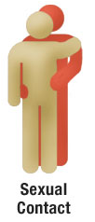
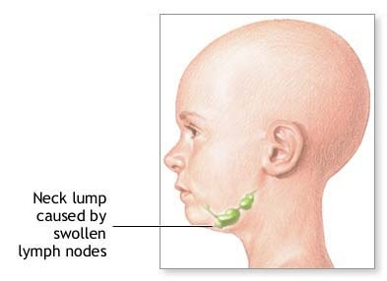
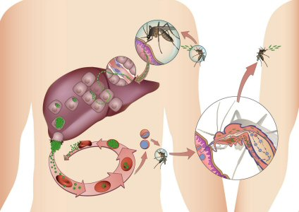
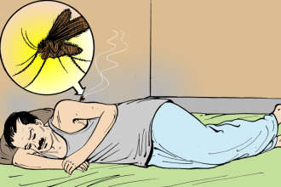
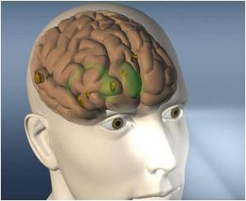
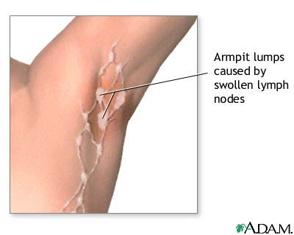
Organ-specific and tissue-specific manifestations
An infection like HIV, that comes into the body via the sexual organs, will spread to lymph nodes all over the body.
Malaria-causing microbes, entering through a mosquito bite, will go to the liver, and then to the red blood cells.
The virus causing Japanese encephalitis, or brain fever, will similarly enter through a mosquito bite.
But it goes on to infect the brain.
Small oval shaped organs important in functioning of immune system.

Slide 5

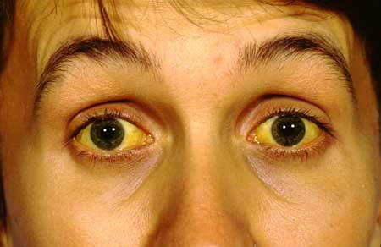
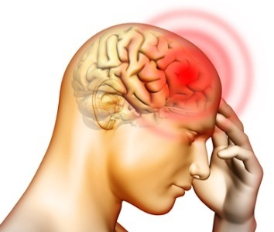
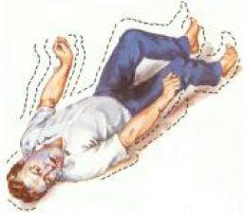
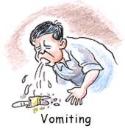
Organ-specific and tissue-specific manifestations
The signs and symptoms of a disease will thus depend on the tissue or organ which the microbe targets.
If the lungs are the targets, then symptoms will be cough
If the liver is targeted, there will be jaundice.
If the brain is the target, we will observe headaches,
and breathlessness.
vomiting,
fits or unconsciousness.

Slide 6
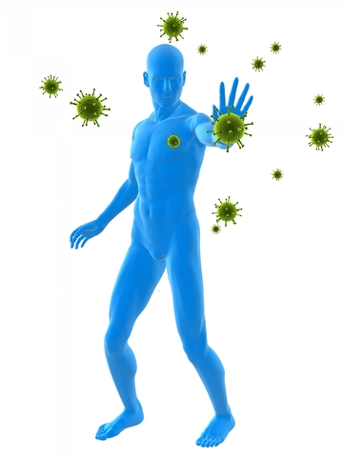
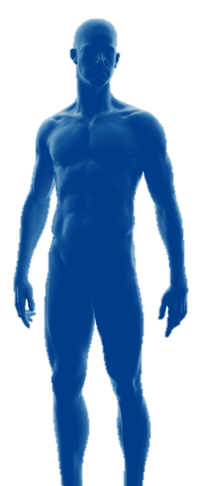
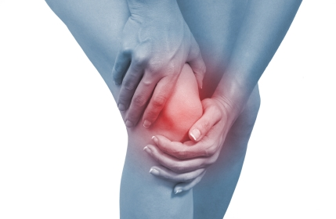
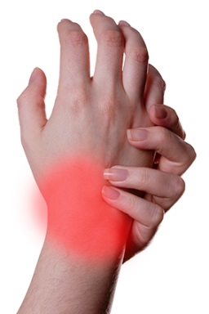
Organ-specific and tissue-specific manifestations
In addition to these tissue-specific effects of infectious disease, there will be other common effects too.
Most of these common effects depend on the fact that the body’s immune system is activated in response to infection.
An active immune system recruits many cells to the affected tissue to kill off the disease-causing microbes.
This recruitment process is called inflammation.
As a part of this process, there are local effects such as swelling and pain, and general effects such as fever.

Slide 7
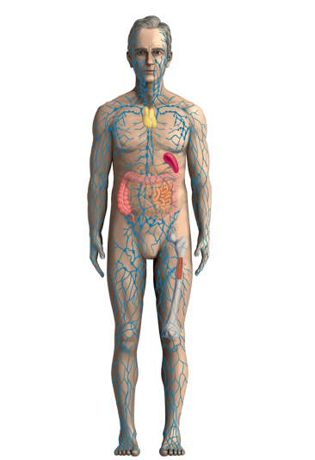


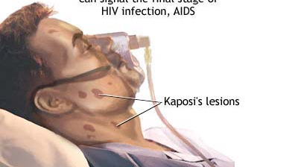


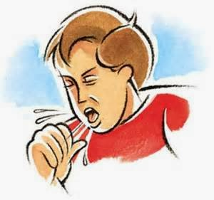
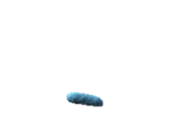
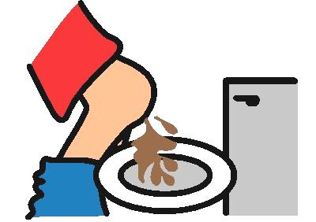
Organ-specific and tissue-specific manifestations
In some cases, the tissue-specificity of the infection leads to very general-seeming effects.
For example, in HIV infection, the virus goes to the immune system and damages its function.
Thus, many of the effects of HIV-AIDS are because the body can no longer fight off the many minor infections that we face everyday.
Instead, every small cold can become pneumonia.
Similarly, a minor gut infection can produce major diarrhoea with blood loss.
Ultimately, it is these other infections that kill people suffering from HIV-AIDS.

Slide 8








Organ-specific and tissue-specific manifestations
The severity of disease manifestations depend on the number of microbes in the body.
If the number of microbes is very small, the disease manifestations may be minor or unnoticed.
But if the number is of the same microbe large, the disease can be severe enough to be life-threatening.
The immune system is a major factor that determines the number of microbes surviving in the body.

